Slide 1
LINUX SYSTEM PROGRAMMING
Operating SYSTEM

Slide 2
OPERATING SYSTEM OVERVIEW
OS is the most essential software in a computer
OS program manages the hardware
OS acts as an intermediary between the user of a computer and the computer hardware.
The purpose of an OS is to provide an environment in which a user can execute programs in a convenient and efficient manner.
hides the tedious stuff
Notes:
Point 1 : Galvin - Preface

Slide 3
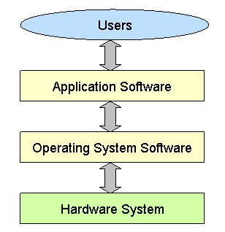

Slide 4
Operating System Functions
Functions of OS
File Mgmt
Memory
I/O Management
Process Mgmt
Job
Scheduling

Slide 5
OS Services
User Interface
Program Execution
I/O Operation
File System Manipulation
Communication
Resource Allocation
Accounting
Protection and Security
Notes:
Page 100

Slide 6
Operating System Classification
Operating system
Multiprogramming
Multitasking /
Time Sharing
Multiprocesser
Multithreading
Uni programming
Notes:
Actual Page : Galvin 75 onwards
Section 1.4 , Page No , 15 onwards
The characteristics of uniprogramming are as follows: - Uni programming allows only one program to be present in memory at a time. - The resources are provided to the single program that is present in the memory at that time. - Since only one program is loaded the size is small as well. Characteristics of multiprogramming: - Multiple programs can be present in the memory at a given time. - The resources are dynamically allocated. - The size of the memory is larger comparatively.

Slide 7
PROCESS MANAGEMENT
What is a Process?
A process is a Program under execution.
What is the difference between Program and Process?
A program is a passive entity that resides on a disk where as a process is an active entity residing in the RAM
Notes:
http://www.hep.wisc.edu/~pinghc/Process_Memory.htm
When an executable program is read into system memory by the kernel and executed, it becomes a process. We can consider system memory to be divided into two distinct regions. One is user space, and the other is kernel Space. Every process has is own user space (about 1GB virtual space) and are prevented from interfering with one another. The mode change which is from user mode to kernel mode is called a context switch.

Slide 8
Memory Segments of a Process
USER SPACE
Text Segment
Data Segment
Stack Segment
KERNEL SPACE
PCB : DS in OS containing the information needed to manage a particular process

Slide 9
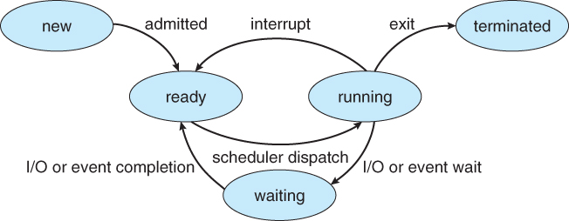
Process States
New - The process is in the stage of being created.
Ready - The process has all the resources available that it needs to run, but the CPU is not currently working on this process's instructions.
Running - The CPU is working on this process's instructions.
Waiting - The process is waiting for some resource to become available or for some event to occur.
The process is waiting for some event to finish
Terminated - The process has completed.

Slide 10
PCB Information
Process ID.
Process State - Holds the current state of a Process(Running, waiting, etc.,).
CPU registers and Program Counter - These need to be saved and restored when swapping processes in and out of the CPU.
CPU-Scheduling information - Such as priority information and pointers to scheduling queues.
Memory-Management information - E.g. page tables or segment tables.
Accounting information - user and kernel CPU time consumed, account numbers, limits, etc.
I/O Status information - Devices allocated, open file tables, etc.

Slide 11
Process Scheduler
Long Term Scheduler (Job Scheduler)
The long-term scheduler, or admission scheduler, decides which jobs or processes are to be admitted to the ready queue.
The long term scheduler is responsible for controlling the degree of multiprogramming.
The medium-term scheduler
The medium-term scheduler may decide to swap out a process which has not been active for some time, or a process which has a low priority, or a process which is page faulting frequently
Short Term Scheduler (CPU Scheduler)
The short-term scheduler decides which of the ready, in-memory processes is to be executed (allocated a CPU).
The short-term scheduler makes scheduling decisions much more frequently than the long-term or mid-term schedulers - a scheduling decision will at a minimum have to be made after every time slice, and these are very short.
Notes:
Page 88 (Actual page in ebook : 148)

Slide 12
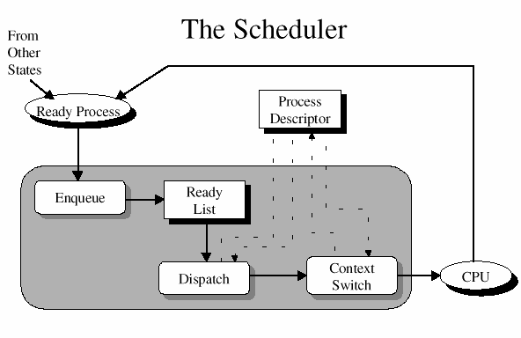

Slide 13
Scheduling Criteria

Slide 14
Scheduling Policies
FCFS
SJF
Priority Scheduling
RR

Slide 15
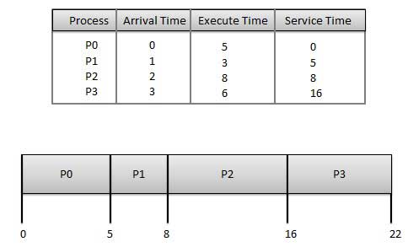
FCFS

Slide 16
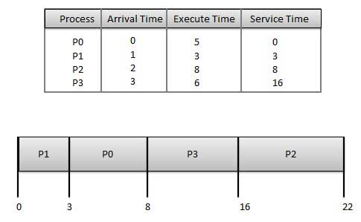

Slide 17
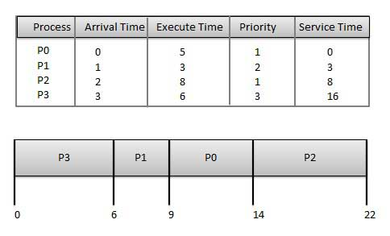

Slide 18
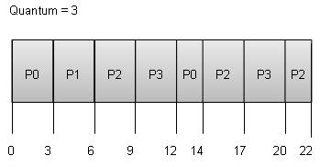

Slide 19
File Management
Types of Files
Ordinary Files
Directory Files
Special Files

Slide 20
Components of Unix System
Other application programs
sh
nroff
who
cpp
Kernel
a.out
Hardware
comp
date
cc
as
wc
id
vi
grep
ed
Other application programs
Notes:
Kernel - responsible for:
interface to the hardware
provide applications with system services
control the resources (memory, disks, CPU...)
shell responsible for:
user interface
Different utility programs

Slide 21
Some of Unix Like Systems
BSD UNIX
Linux
Android
Solaris
Mac OS
iOS

Slide 24
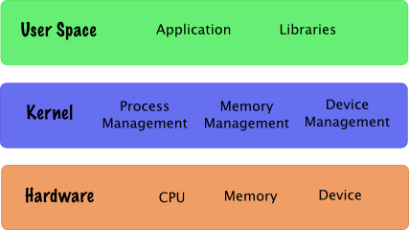
User Space and Kernal
Notes:
A modern computer operating system usually segregates virtual memory into kernel space and user space.^{[a]} Primarily, this separation serves to protect data and functionality from faults (by improving fault tolerance) and malicious behaviour (by providingcomputer security).
Kernel space is strictly reserved for running privileged kernel, kernel extensions, and mostdevice drivers. In contrast, user space is the memory area where application software and some drivers execute.
The kernel is the core of the operating system. It normally has full access to all memory and machine hardware (and everything else on the machine. To keep the machine as stable as possible, you normally want only the most trusted, well-tested code to run in kernel mode/kernel space

Slide 25
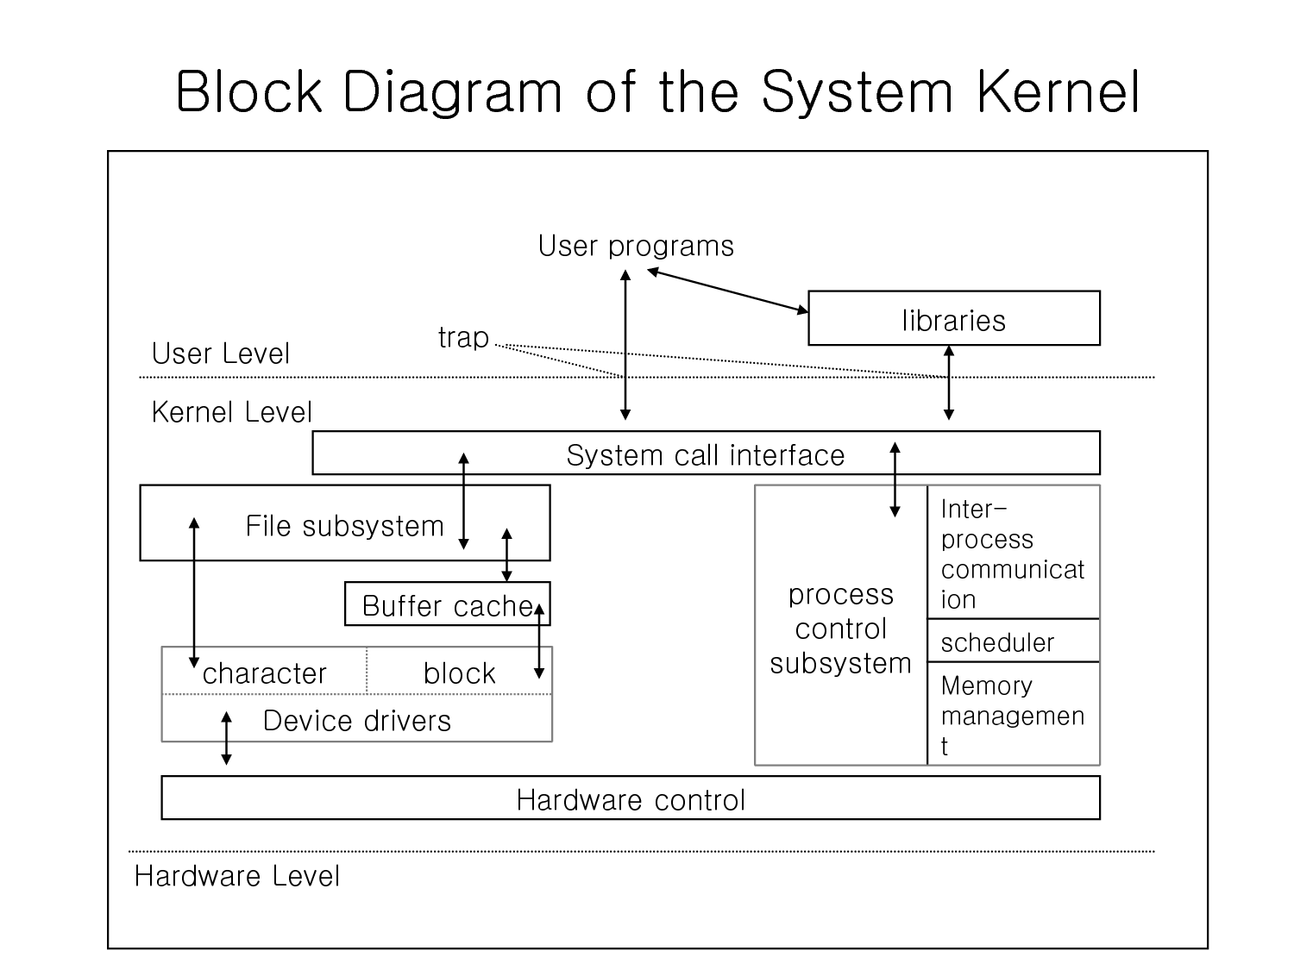

Slide 26
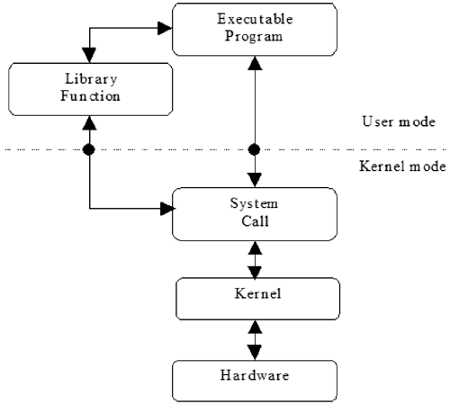
Notes:
Mode switch (not context switch)

Slide 27
Modes of execution
User mode:
process is allowed to access its own address space, ie. its text, data, stack etc..
Every user process executes in user mode.
preemptive
Kernel mode:
process is allowed to access the kernel’s text
and data as well as process’s address space.
Privileged mode
Kernel runs on behalf of the process
Non-premptive

Slide 28
System call interface
System call interface is a set of functions defined as interface to kernel or kernel entry points.
Applications call system call to avail various kernel services.
Calling system call causes a mode switch from user to kernel mode.

Slide 29
System Calls
Section 2 of the manual contains the pages on system calls.
System calls are OS specific
Library functions are Language Specific.
It is important to remember that some library functions have embedded system calls.
Notes:
IPC in Linux - Page 17, Session 1.3 System Call

Slide 30
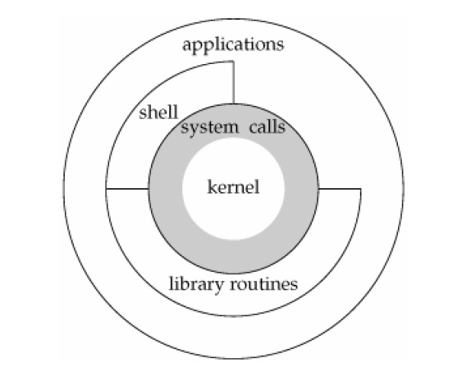
System Call
Notes:
System calls are OS specific
Library functions are Language Specific.
Library functions which require access to sytem resources (eg: Disk , I/O devices) will inturn invoke system calls.
Eg: printf invokes write, malloc invokes brk

Slide 31
